Slide 1



OPERATING SYSTEMS
SECR2043-05
AMINE GHAFIL
MOUAD MEZIGHECHE
MOHAMMED OMAR MOHAMMED BA DOBIAN
ABDULAZIZ MOHAMMED BA QADEEM BA RASHED
Deadlock in a Car Rental System

Slide 2

TABLE OF CONTENTS
1
INTRODUCTION
5
SOLUTION & METHODOLOGY
2
PROBLEM STATEMENT
6
CODE OVERVIEW
3
BACKGROUND
7
NEXT STEPS & FUTURE REFINEMENTS
4
FLOWCHART
8
CONCLUSION

Slide 3

INTRODUCTION
CAR RENTAL SYSTEM: MANAGING CONFLICTS IN CUSTOMER RESERVATIONS
Car rental services offer convenient mobility solutions.
Challenges: Conflicts in customer reservations for the same vehicle.
Addressing clashes crucial for enhancing effectiveness and satisfaction.

Slide 4
PROBLEM STATEMENT
OBJECTIVE: APPLYING OPERATING SYSTEM SECR2043 KNOWLEDGE
Implementing Deadlock Resource Allocation Graph (RAG) in a car rental system.
Simulating deadlocks when multiple users book cars simultaneously.
Demonstrate potential deadlock occurrences and propose solutions

Slide 5

BACKGROUND
EVOLUTION OF CAR RENTAL SERVICES
Pivotal Role: Car rental services provide convenient mobility solutions.
Rising Popularity: Access to a diverse fleet has increased their popularity.
Efficiency Challenges: Conflicts in customer reservations for the same vehicle.
Growing Demand: Increasing demand poses challenges for service providers.
Project Objective: Apply Operating System SECR2043 knowledge to address efficiency challenges in a practical setting.
Notes:
The essential role that car rental services is to provide convenient mobility solution
In recent years, car rental services become popular among people.
Among the challenges that car rental services face are efficiency and growing demands challenges
Our project aims to apply the concept of the course operating system to address efficiency challenges in a practical setting.

Slide 6
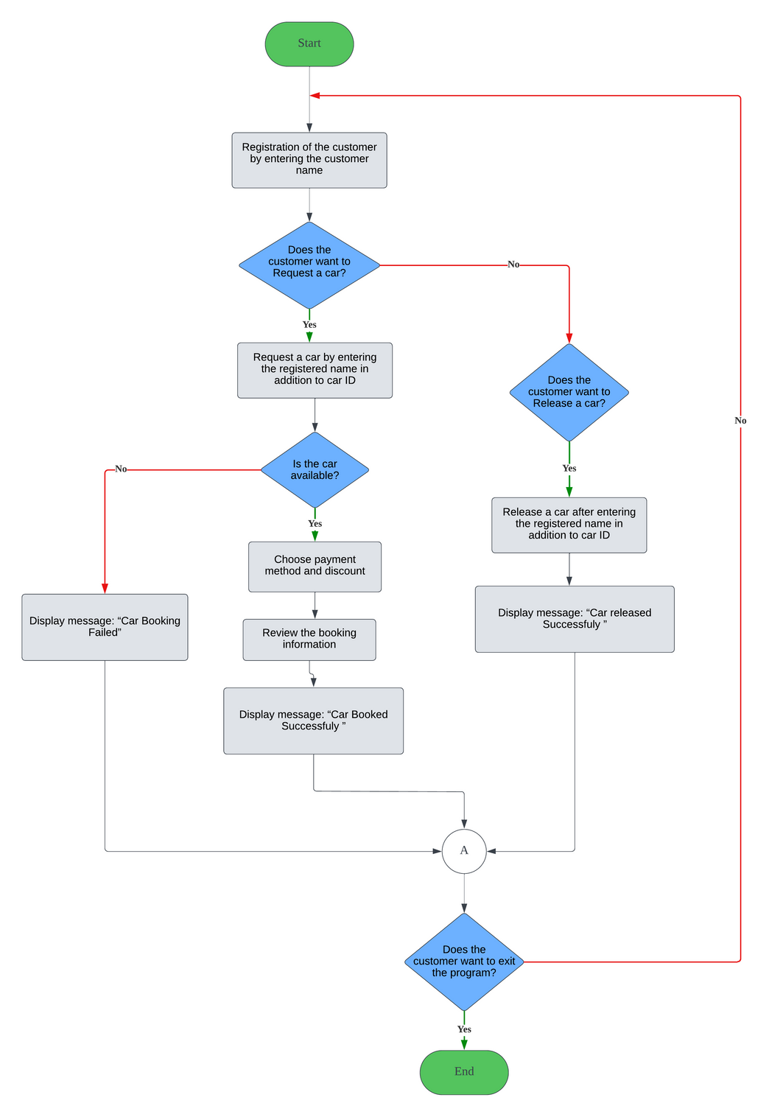
FLOWCHART
Notes:
It is clearly stated in the flowchart that the process starts with the registration of the customer by writing the person's name.
Then after that, if the customer requests a car, he/she needs to write the registered name as well as the car ID.
The system checks for the availability of the car: If the car is available, then a message of ‘car booked successfully’ is displayed and if the car is not available which means another person booked this car, a message of ‘car booking failed’ is displayed.
If that person does not want to request but he/she wants to release a car, then the car will be released after entering the name alongside the ID of the car, and a message of ‘car released successfully’ is displayed.
After those steps, the system checks if the user wants to exit the program, if yes, then the user ends the program. If this is not the case, the process will be repeated again.

Slide 7

SOLUTION & METHODOLOGY
DEADLOCK HANDLING IN CAR RENTAL SYSTEM CODE
Resource Allocation Graph (RAG) Implementation:
Visual representation of dynamic relationships.
Nodes for customers and cars, edges for requests and assignments.
Request and Assignment Handling:
request_car method manages customer requests.
release_car method allows customers to release cars.
Deadlock Detection:
is_system_safe method implements safety algorithm.
Identifies conflicts in RAG, ensuring system safety.
Deadlock Avoidance - Safety Algorithm:
Grants requests only when the system remains safe.
Foundational implementation, may require refinement.
User Interaction and CLI:
CarRentalSystemCLI provides a user-friendly interface.
Seamless interaction with deadlock-handling mechanisms.

Slide 8
CODE OVERVIEW

Slide 9

NEXT STEPS & FUTURE REFINEMENTS
EVOLVING THE CAR RENTAL SYSTEM
Continuous refinement of safety algorithm.
Adaptability to more complex scenarios.
Future enhancements for comprehensive deadlock avoidance.

Slide 10
CONCLUSION
STRATEGIC DEADLOCK RESOLUTION METHODOLOGY
Nuanced approach to conflicts in simultaneous reservations.
Resource Allocation Graph (RAG) as a dynamic framework.
Safety algorithm for deadlock detection and avoidance.
User-friendly interface enhances practicality.

Slide 11
THANK YOU FOR WACHING

Slide 12

AMINE GHAFIL
A20EE4010

Slide 13


MOHAMMED OMAR MOHAMMED BA DOBIAN
A19EE4049

Slide 14

ABDULAZIZ MOHAMMED BA QADEEM BA RASHED
A19EE4053

Slide 15

MOUAD MEZIGHECHE
A19EE4069

